Slide 1
ICBYR 2022 Events

Slide 2
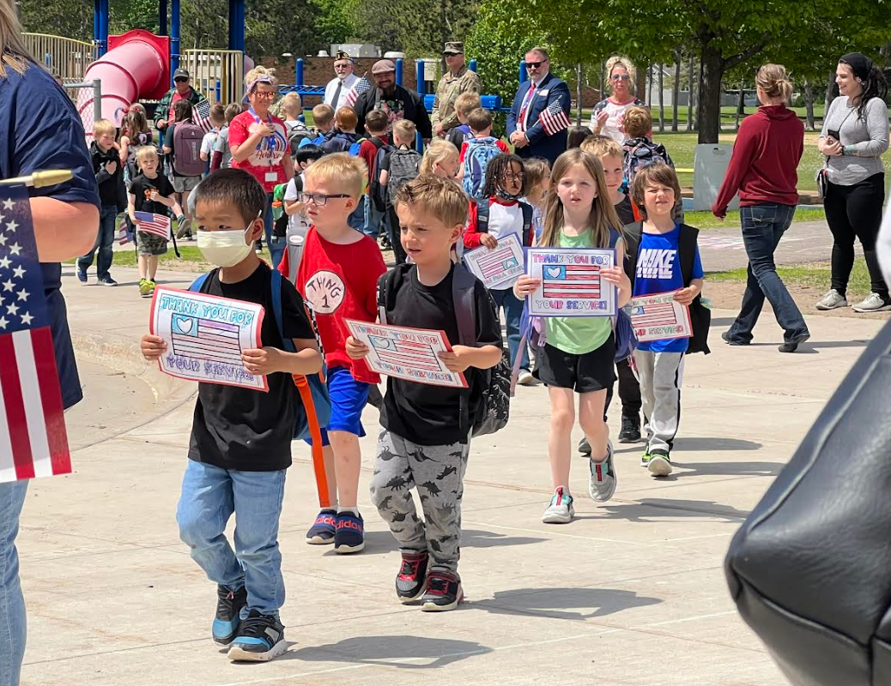
Silent Dismissal – May 27 – Cambridge Primary School

Slide 3
Silent Dismissal – May 27 – Cambridge Primary School
Isanti County veterans were invited to participate in “Silent Dismissal” at the Cambridge Primary School on May 27th, the Friday before Memorial Day weekend to honor all veterans.
Several Isanti County Beyond the Yellow Ribbon Task Force members participated in the event.
The children from the Cambridge Primary and Intermediate Schools marched by the veterans, hands over their hearts, carrying American flags and patriotic artwork they had made. They were orderly and silent to honor the veterans.
It was a beautiful site and if you didn’t shed a tear or two you did better than I did!
Thank you to the teachers who organized this.

Slide 4
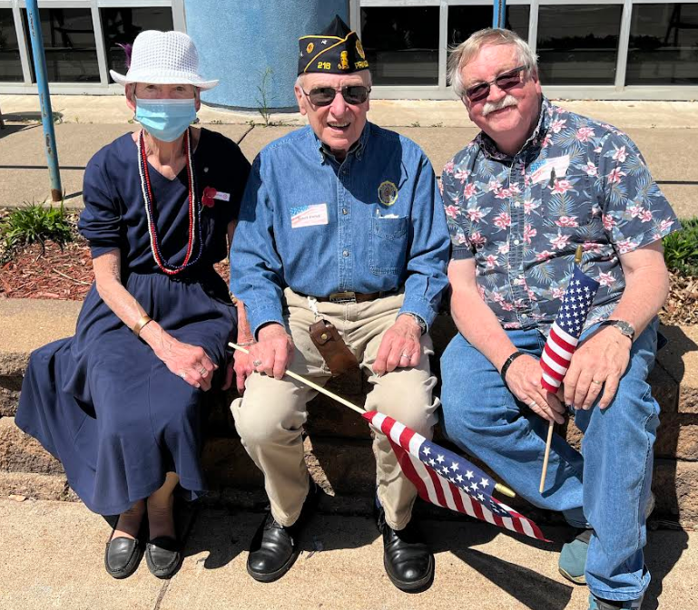
Silent Dismissal – May 27 – Cambridge Primary School

Slide 5
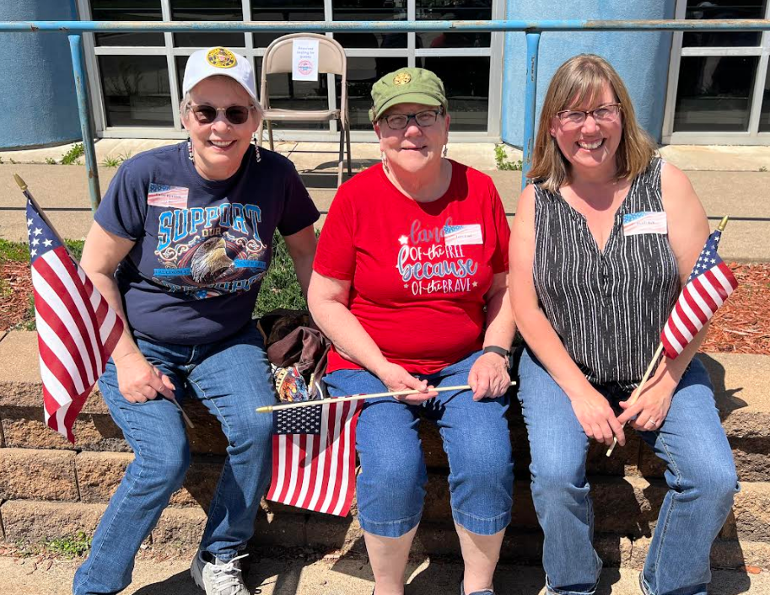
Silent Dismissal – May 27 – Cambridge Primary School

Slide 6
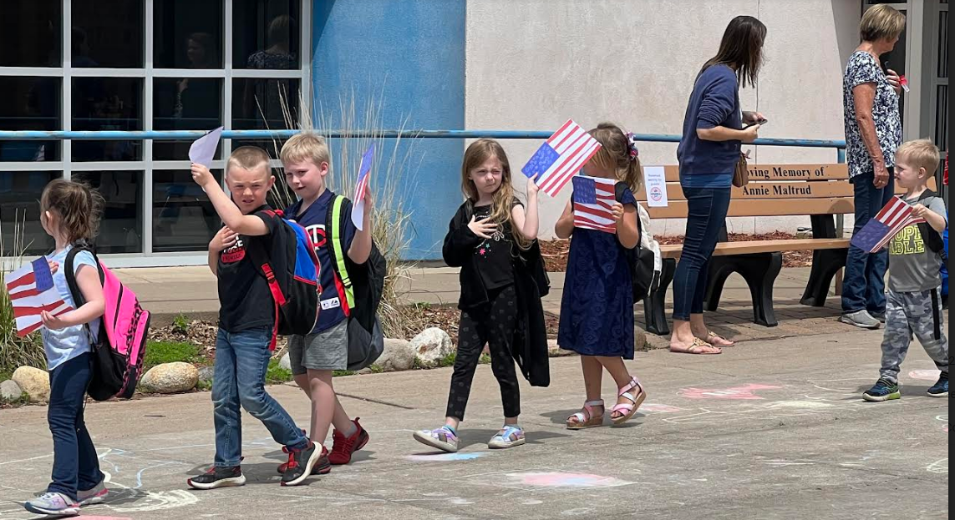
Silent Dismissal – May 27 – Cambridge Primary School

Slide 7
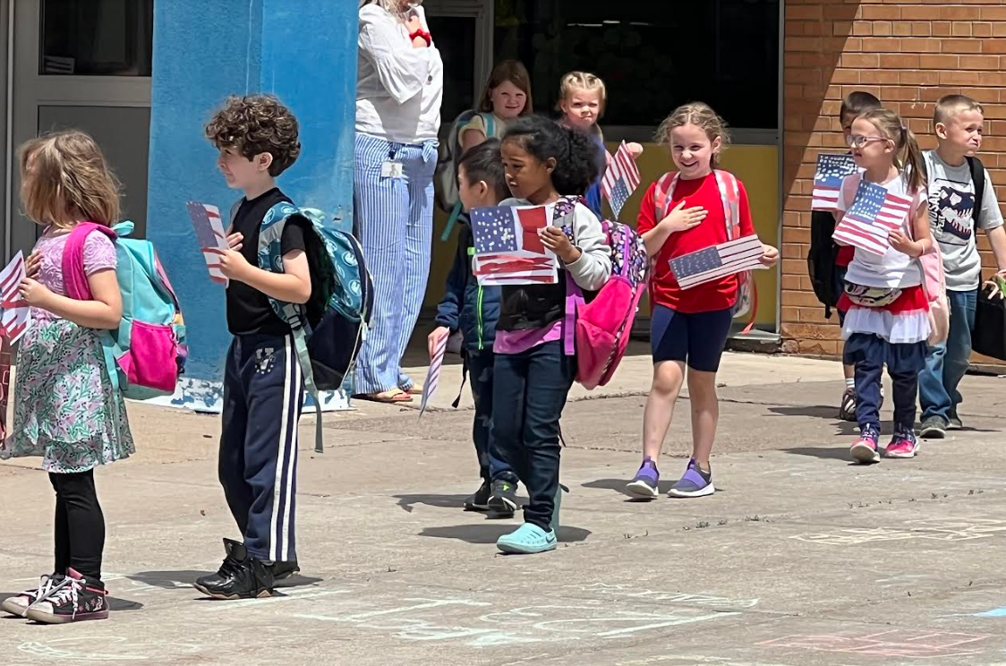
Silent Dismissal – May 27 – Cambridge Primary School

Slide 8
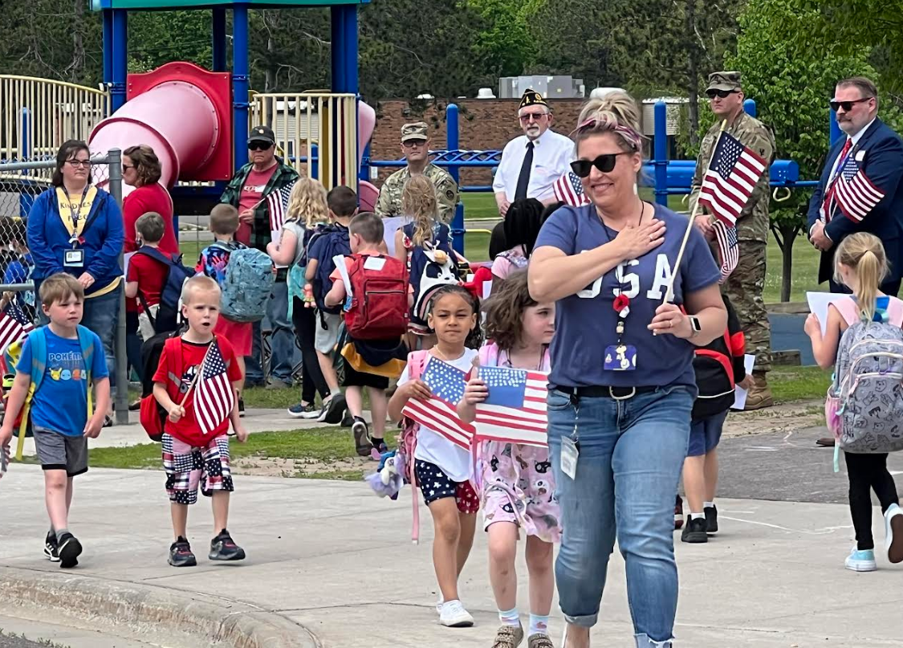
Silent Dismissal – May 27 – Cambridge Primary School

Slide 9
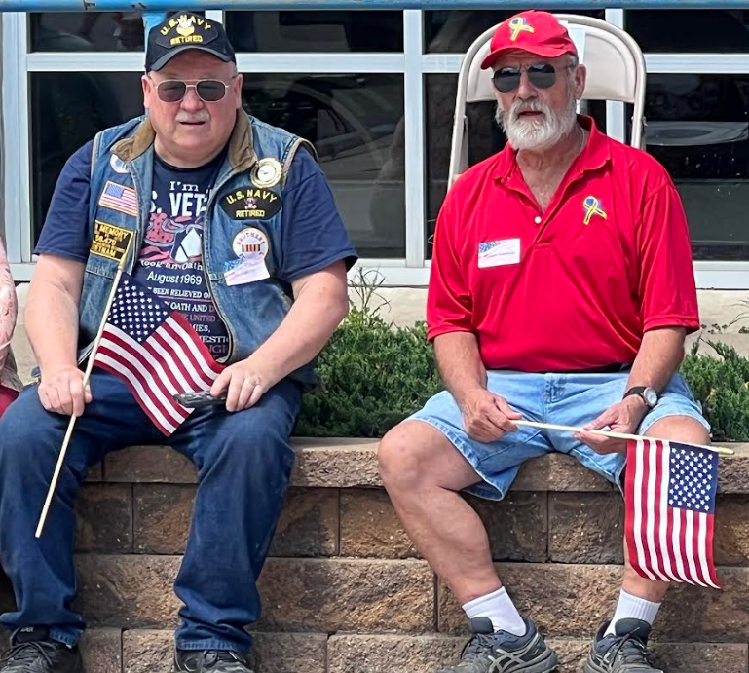
Silent Dismissal – May 27 – Cambridge Primary School

Slide 10
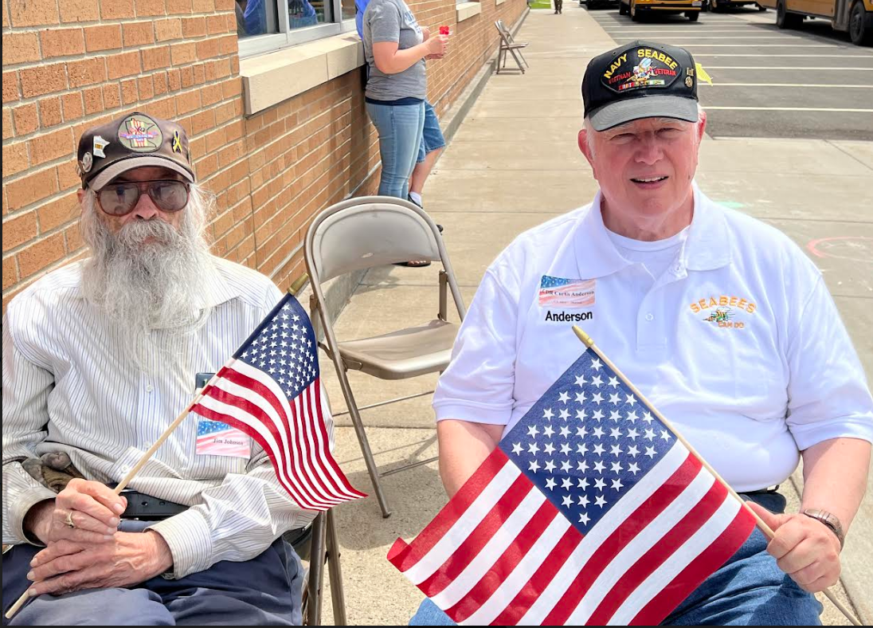
Silent Dismissal – May 27 – Cambridge Primary School

Slide 11
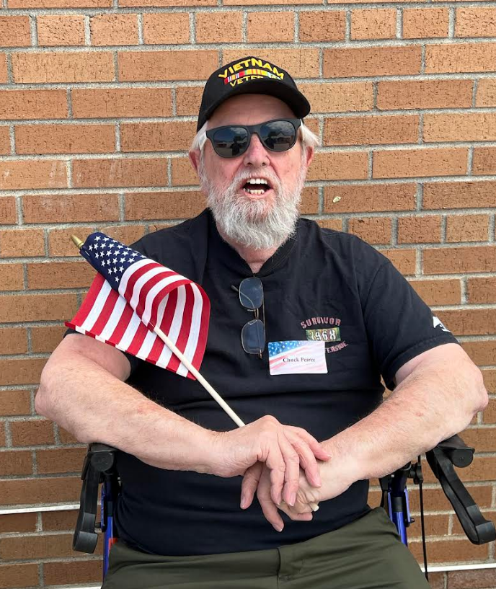
Silent Dismissal – May 27 – Cambridge Primary School

Slide 12
Braham Appreciation Days Parade – June 4
Isanti County Beyond the Yellow Ribbon Task Force members participated in the Braham Appreciation Days on June 4th.
What a beautiful day!

Slide 13
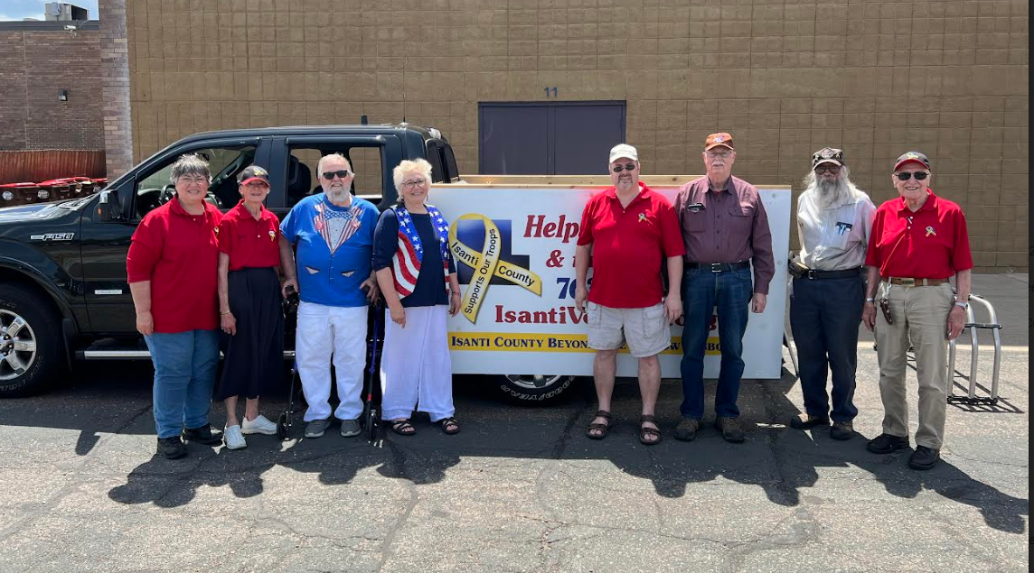
Braham Appreciation Days Parade – June 4

